Slide 1
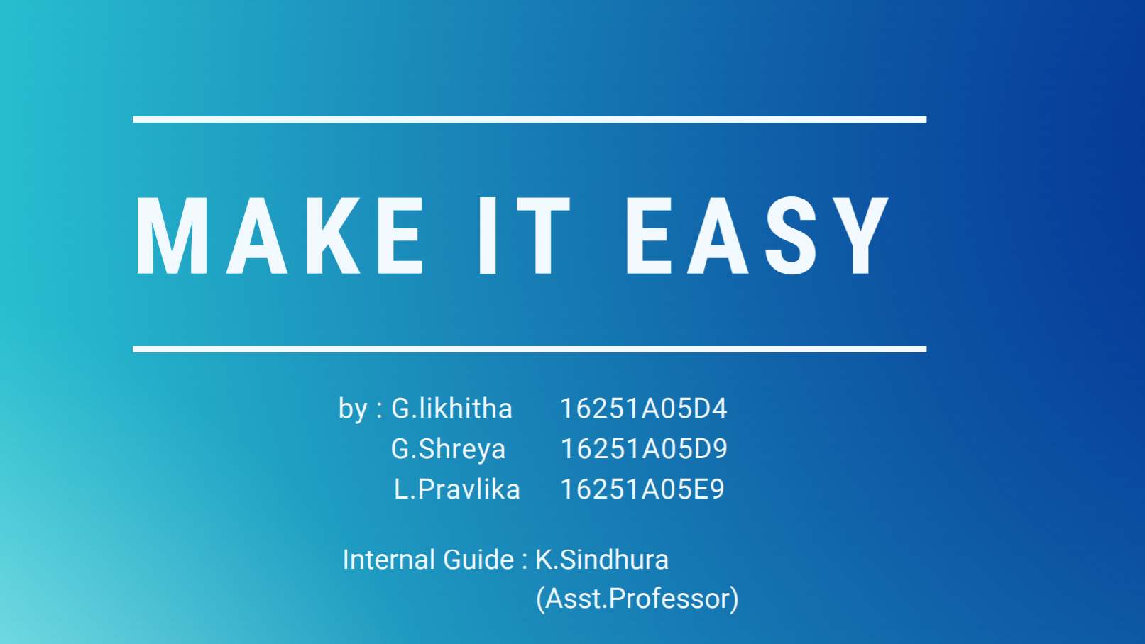

Slide 2
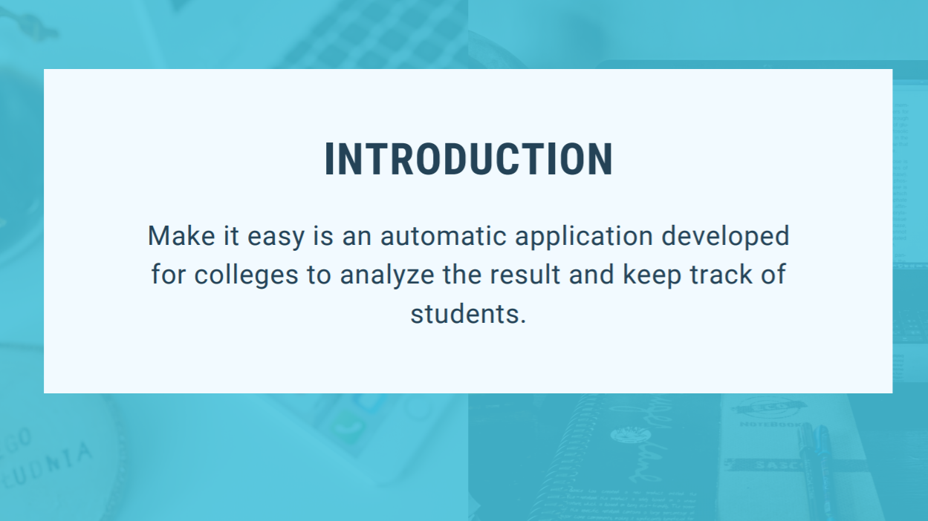

Slide 3
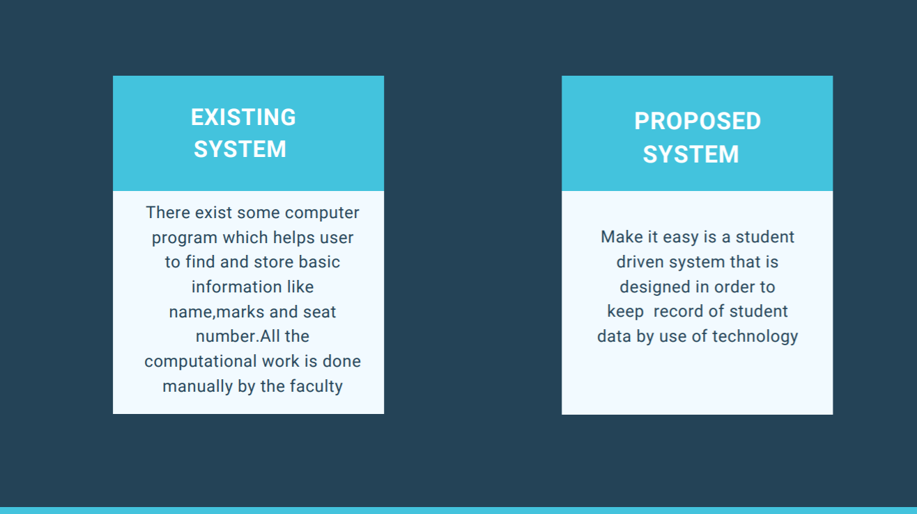

Slide 4
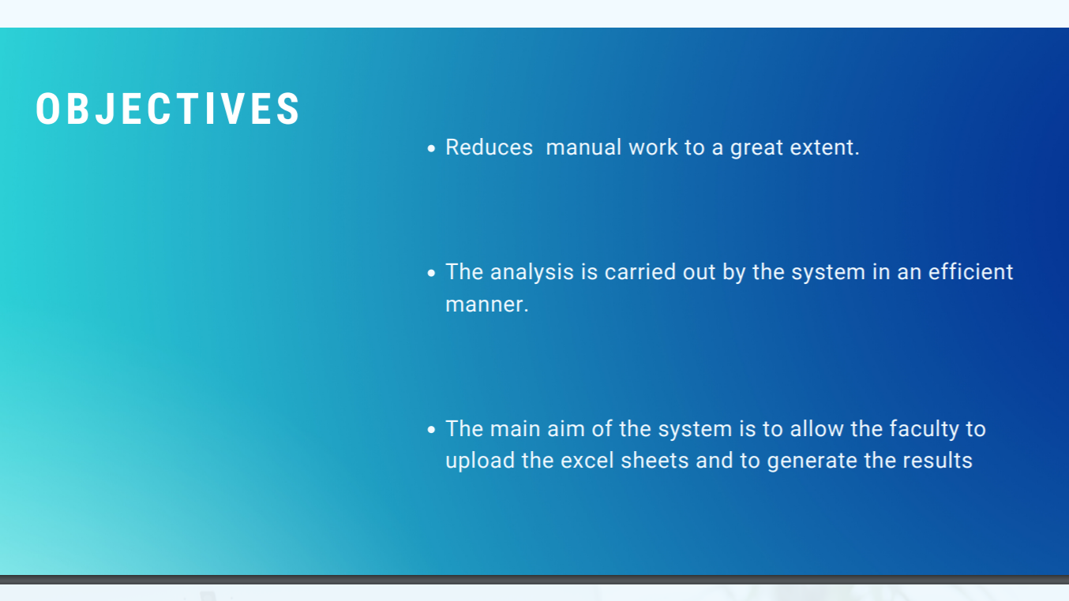

Slide 5

Revaluation result
Upload two excel sheets
Compare to excel sheets
Displays updated excel sheet result
Class details
Choose particular section
Analyse whole class grades
Displays result
RESULT ANALYSIS
SYSTEM
Faculty details
Choose particular section
Analyse result of given faculty
Displays graph
Subject details
Subject wise grades
Subject wise percentages
Subject wise failures

Slide 6

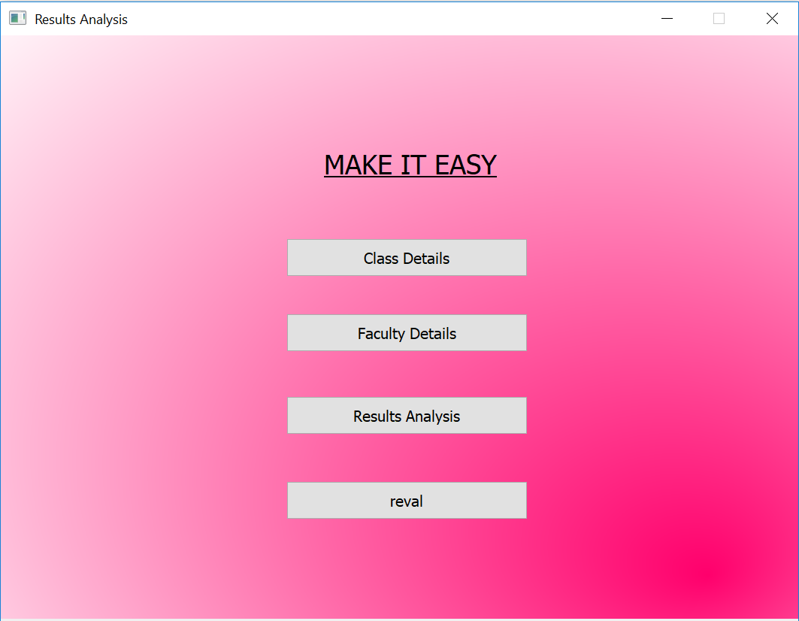

Slide 7
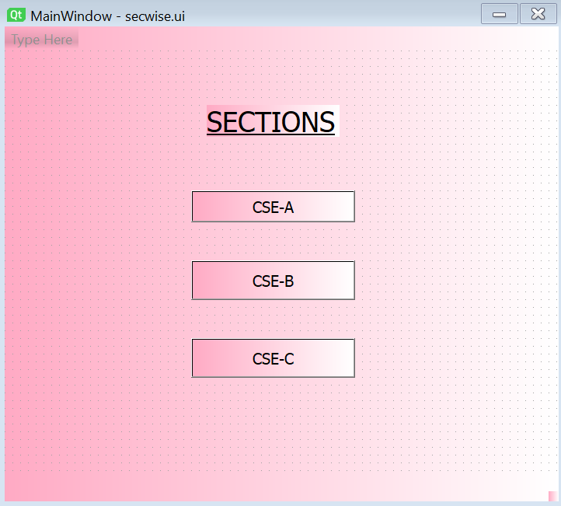
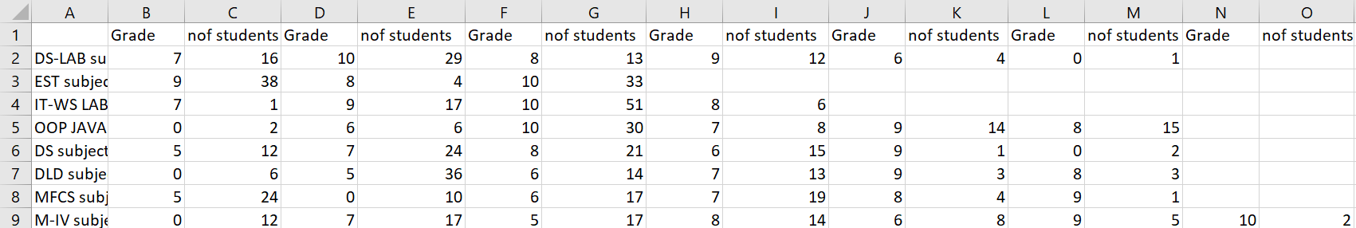

Slide 8
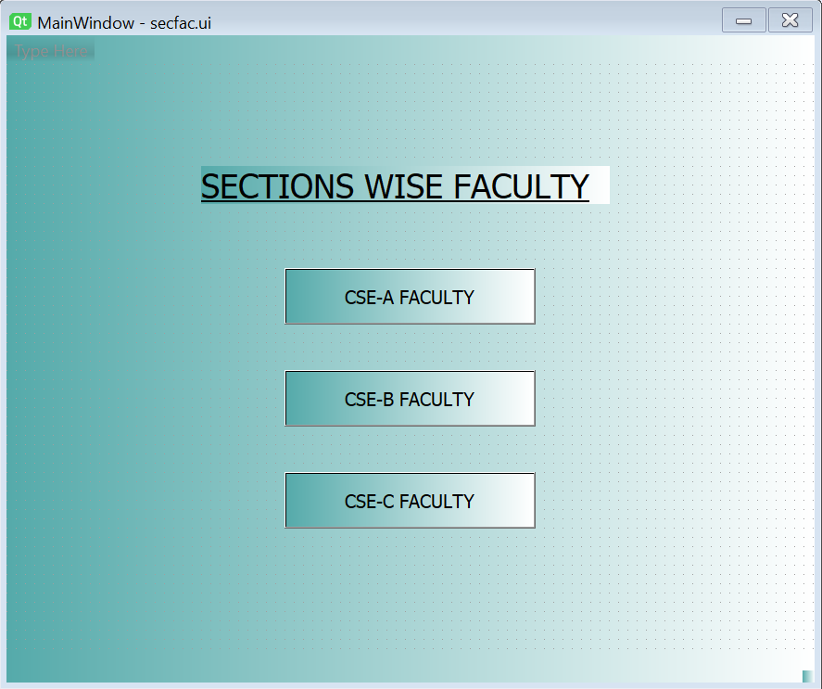
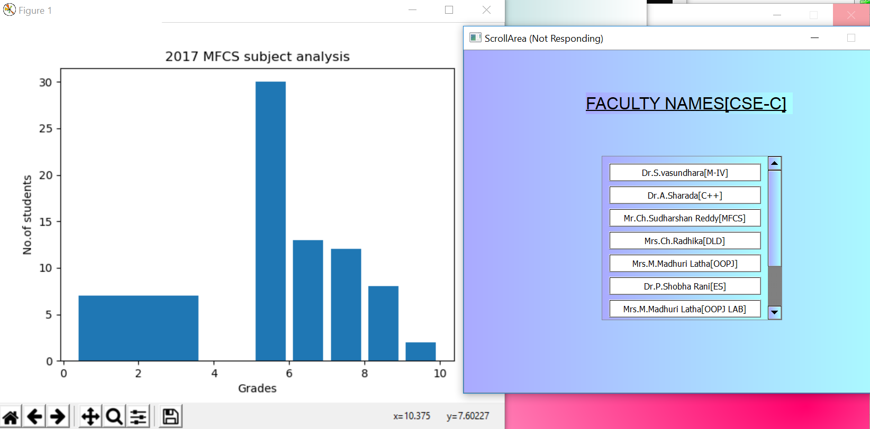

Slide 9
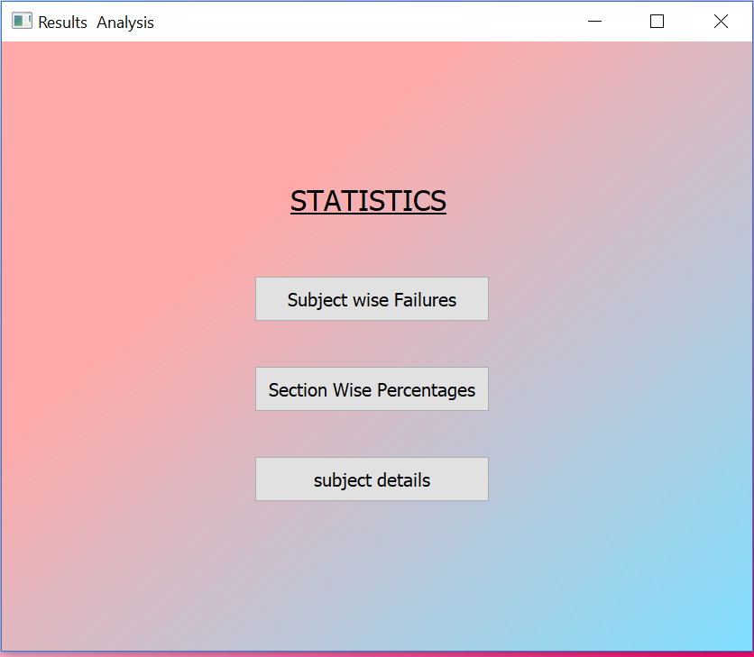
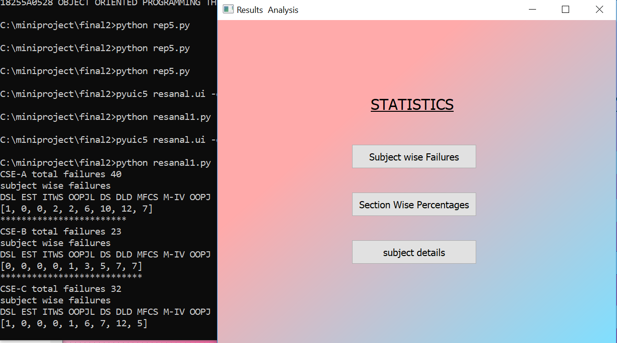

Slide 10
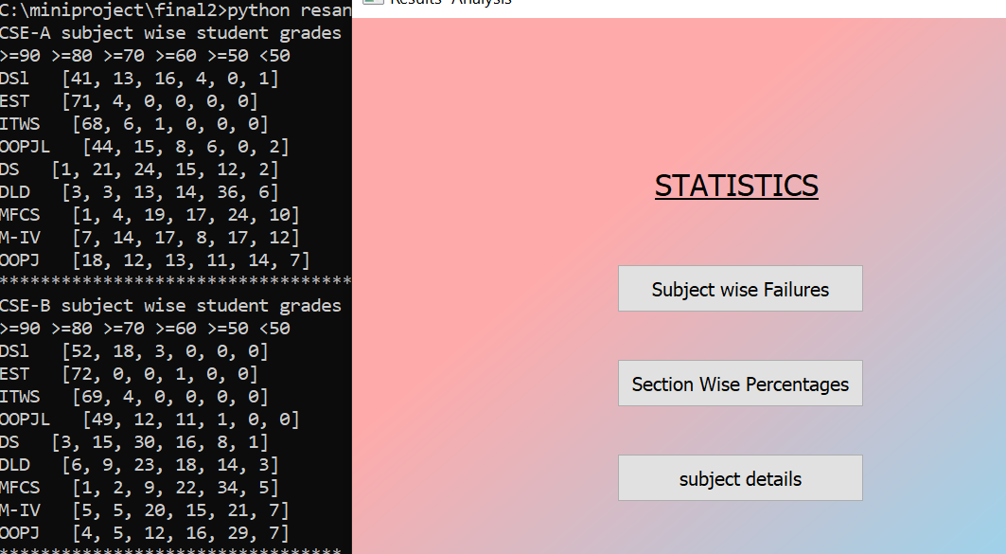

Slide 11
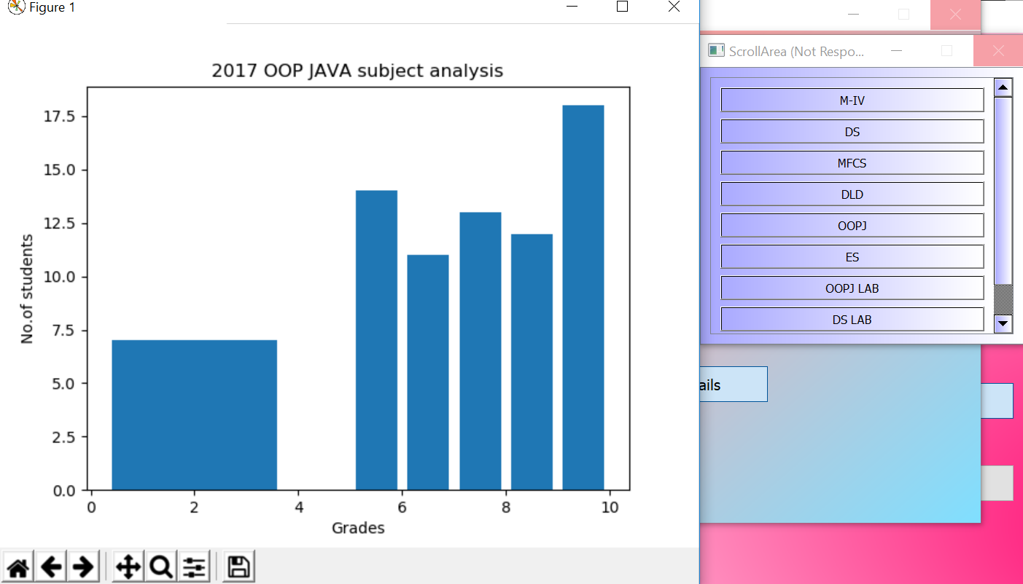

Slide 12
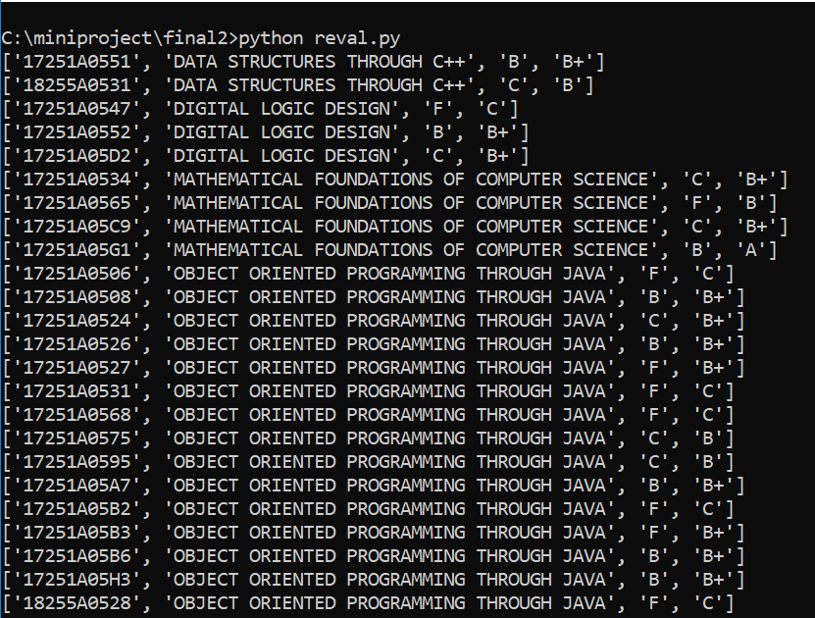

Slide 13
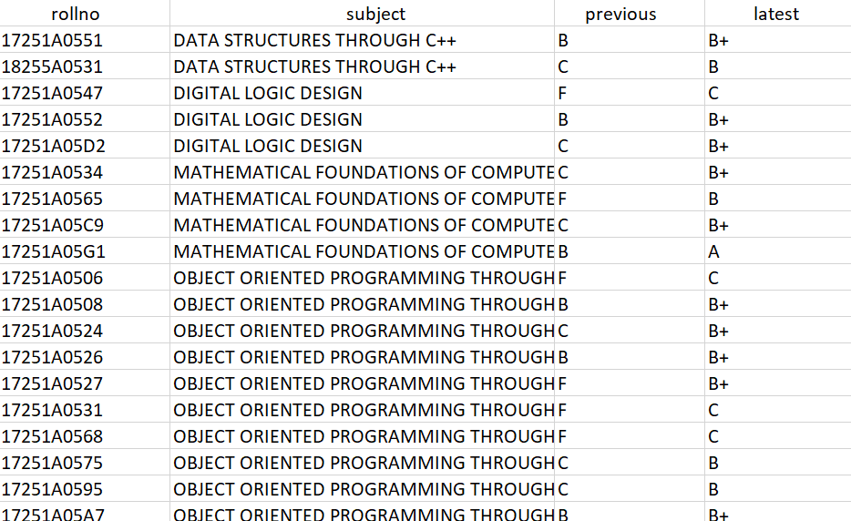

Slide 14
THANKYOU

